Slide 1
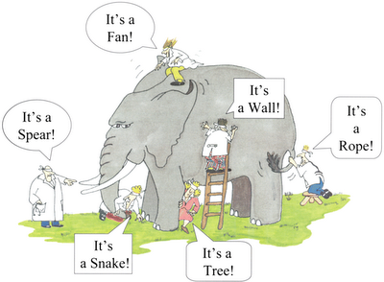
Key idea
Characterize a graph by a bivariate distribution that specifies the probability of the two vertices appearing at both ends of a “randomly” selected path in the graph.
An old saying, “blind men and an elephant.”
A bunch of blind persons try to figure out what an elephant looks like by touching the elephant with their both hands.”

Slide 2
Unified framework
Since V and W are the two ends of a randomly selected path, the marginal distributions of V and W could be used as centralities of networks.
We can then use the bivariate distribution p(v,w) to measure the similarity between two nodes v and w.

Slide 3
A general probabilistic framework
Instead of characterizing a graph by its adjacency matrix, we characterize a graph by a bivariate distribution.
A straightforward way is to normalize the adjacency matrix by the total number of edges.
Probabilistic interpretation: the two random variables V and W represent the two ends of a uniformly selected edge (why 2m?)

Slide 4
Bivariate distribution from the adjacency matrix
Marginal distribution:
This is simply the degree centrality.
Modularity matrix and modularity

Slide 5
How to generate a bivariate distribution from a graph
The idea is to pick the two ends of a randomly selected path.
Katz similarity:
Katz centrality:

Slide 6
PageRank
Initially, every web page is chosen randomly with the same probability.
With probability α, perform a random walk on the web by randomly choosing a hyperlink in a page.
With probability 1-α, stop the random walk and select the two ends of the path.

Slide 7
Assortative mixing by scalar characteristic
Assign each vertex v a value f(v).
Define assortativity coefficient by the Pearson correlation coefficient.

